Slide 1

September 2022
Network Toolkit

Slide 2

ABOUT THIS
TOOLKIT
As a valued member of the Feeding America network, we are grateful for your leadership and commitment to people facing hunger in your community as we work together to end hunger in America.
This toolkit includes this year’s Hunger Action Month campaign materials and turnkey resources like customizable language and creative assets, as well as engagement ideas to inspire your local communities to take action and join the fight to end hunger.
Thank you for your partnership and dedication to ending hunger.
2 HUNGER ACTION MONTH 2022 TOOLKIT

Slide 3
HUNGER ACTION MONTH
What is Hunger Action Month?
September is Hunger Action Month — the Feeding America network’s annual nationwide campaign designed to inspire people to take action and raise awareness of hunger in the United States. You can help engage your community by leveraging the materials, ideas, and resources throughout this toolkit. ​
What is Hunger Action Day?
September 23rd is Hunger Action Day — a day where collective efforts across the country are focused for greater impact.
Go Orange
Orange is the color of hunger relief. During Hunger Action Month we join together by wearing orange, turning our city landmarks orange, and raising our voices all across the country on behalf of the millions of people facing hunger in America.
3 HUNGER ACTION MONTH 2022 TOOLKIT

Slide 4


HUNGER ACTION MONTH LOGOS
Horizontal Logo
Vertical Logo
LINK to files
4 HUNGER ACTION MONTH 2022 TOOLKIT

Slide 5


2022 CAMPAIGN
Food shouldn’t be an impossible choice.
We know hunger exists in every community in the U.S. We also know rural communities and communities of color are disproportionately impacted by economic instability—like the soaring inflation rate that is the highest it's been in 40 years. Neighbors who have already been working to overcome the hardships wrought by the effects of the pandemic, are now faced with a 10% increase to buy groceries for their family. When difficult times hit, food can be the first thing people forego to make ends meet.
For many, a daily meal is a simple choice of what to eat. But for people facing hunger, a daily meal poses a very different type of choice. It's often an impossible choice between food and other crucial needs, such as electricity, childcare or medicine.
This year's Hunger Action Month campaign creates empathy with this issue by presenting the impossible choices of hunger with thought-provoking visual metaphors that prime our audience to expect food, but then reveal the impossible choices instead. Medical papers pop out of a toaster; light bulbs sit in an egg carton; a steaming breakfast is made of kids' building blocks.
5 HUNGER ACTION MONTH 2022 TOOLKIT

Slide 6
KEY MESSAGES
September is Hunger Action Month—a time when the Feeding America network and the public come together to raise awareness and inspire action to help people facing the impossible choices of hunger.
Hunger impacts every community in the U.S., but rural communities and communities of color are disproportionately impacted.
Households with children, seniors and/or neighbors of color face hunger at much higher rates compared to white people.
45% of food banks reported seeing an increase in the number of people served in April compared to March, according to our May 2022 data.
For millions of people in America, a daily meal isn’t a choice between different dishes. It's a choice between food and other basic needs—like medicine, electricity or childcare.
Food shouldn’t be an impossible choice.
How will you choose to end hunger?
Join the fight to end hunger at [FOOD BANK URL]
#HungerActionMonth
#EndHunger
6 HUNGER ACTION MONTH 2022 TOOLKIT

Slide 7
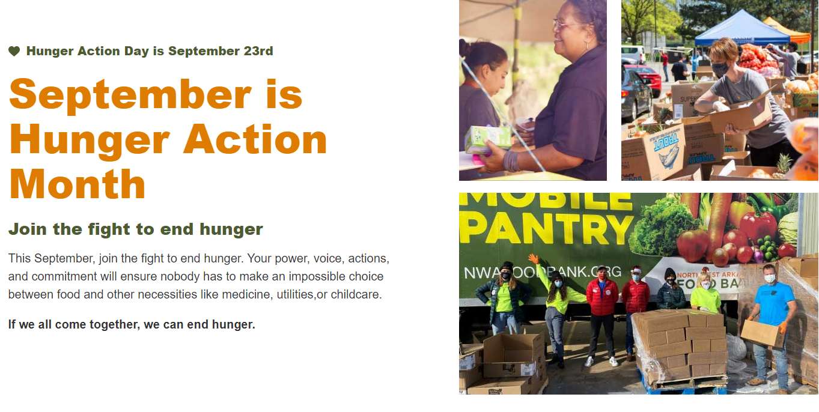
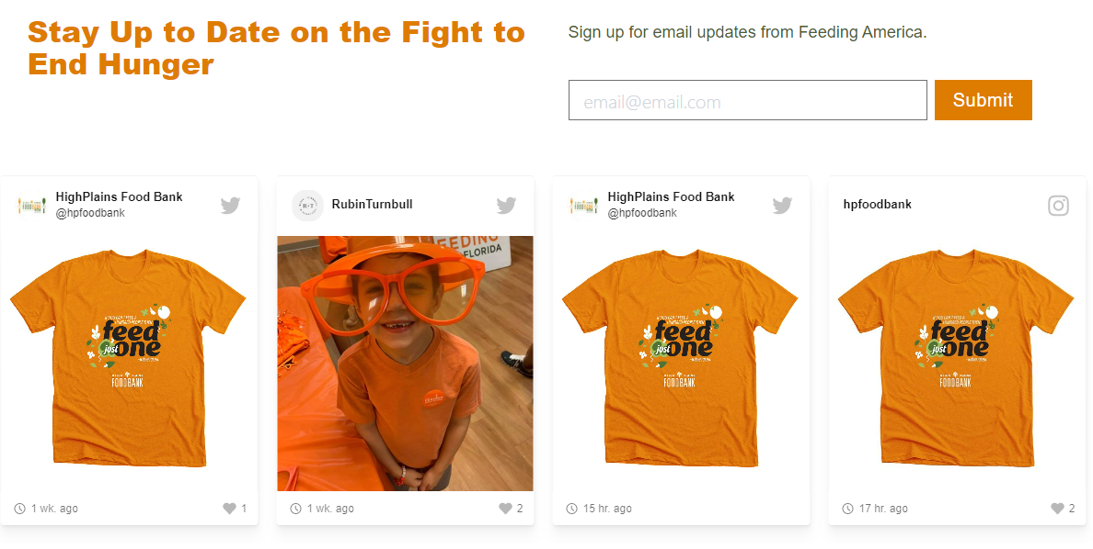
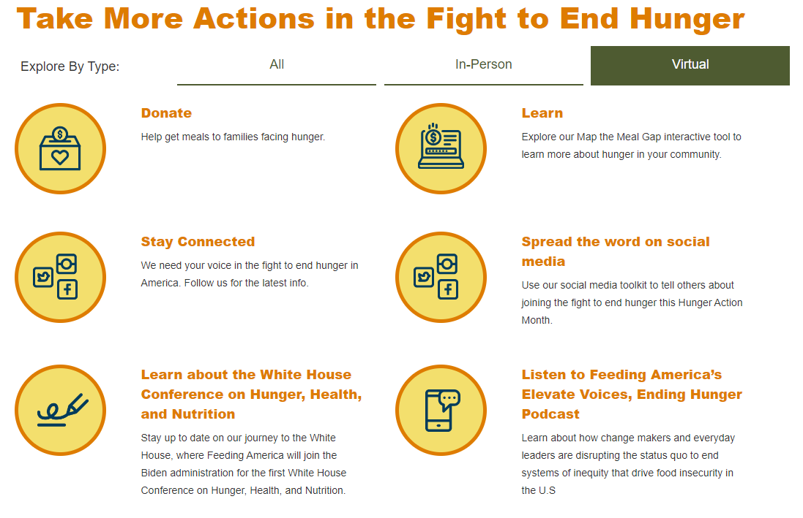
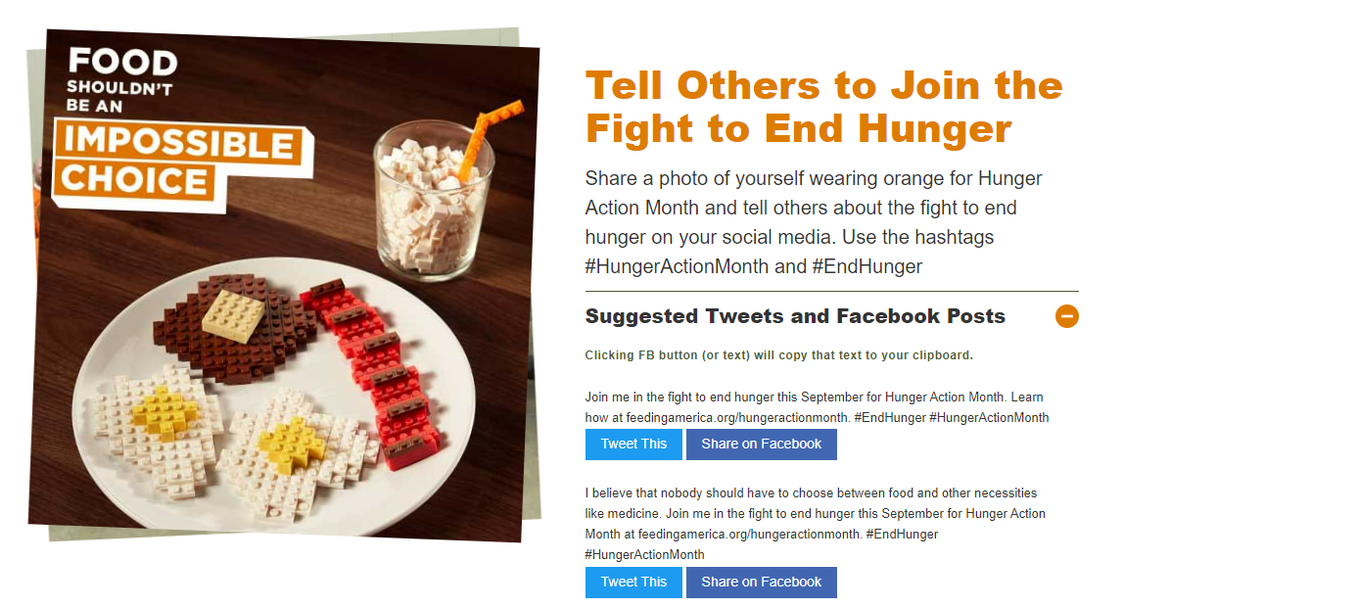
CAMPAIGN LANDING PAGE
FeedingAmerica.org/HungerActionMonth
(new page live 8/26)
7 HUNGER ACTION MONTH 2022 TOOLKIT

Slide 8
FEEDING AMERICA
ACTIVATIONS CALENDAR
8 HUNGER ACTION MONTH 2022 TOOLKIT

Slide 9

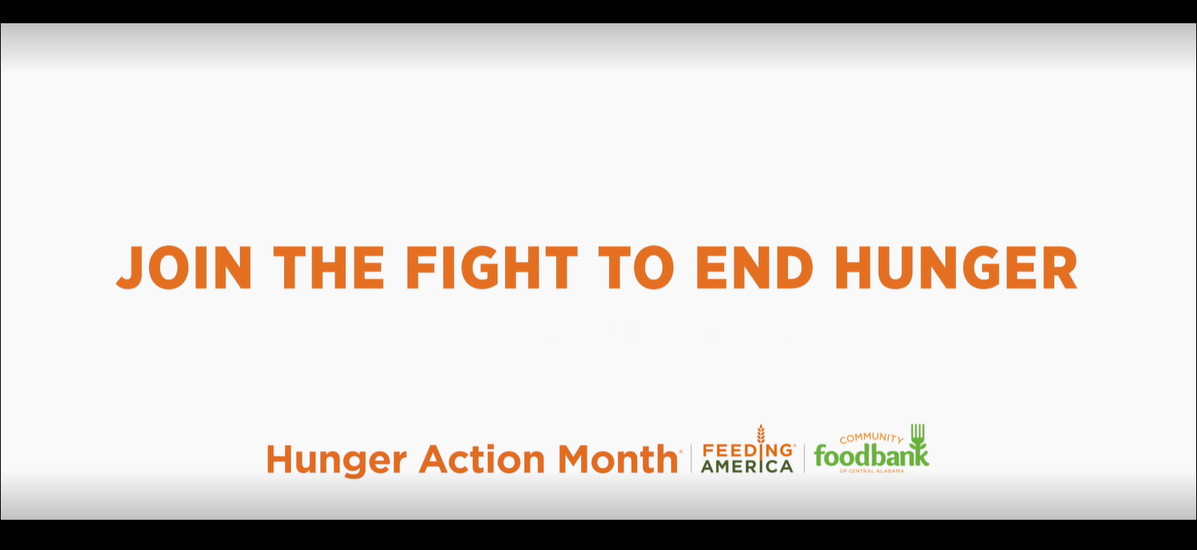
VIDEO
LINK to localized (co-branded) video for each food bank
End card includes food bank logo
Example
9 HUNGER ACTION MONTH 2022 TOOLKIT

Slide 10
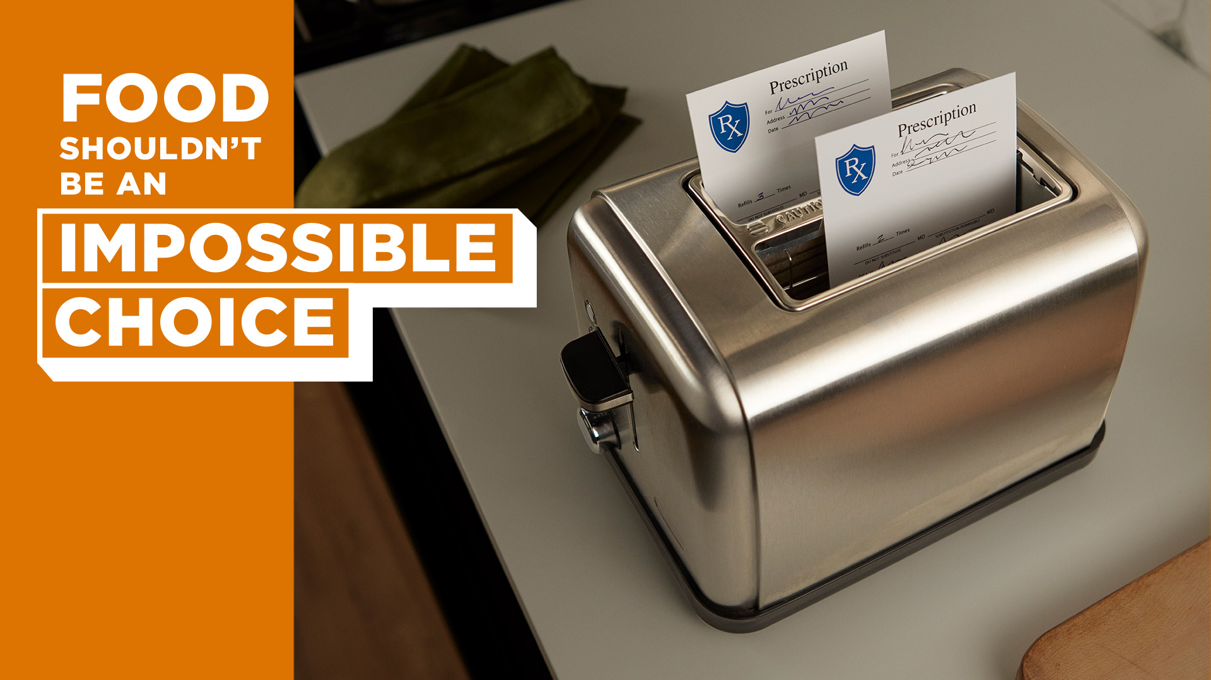


SOCIAL IMAGES
FACEBOOK/TWITTER STATIC
LINK to files
10 HUNGER ACTION MONTH 2022 TOOLKIT

Slide 11
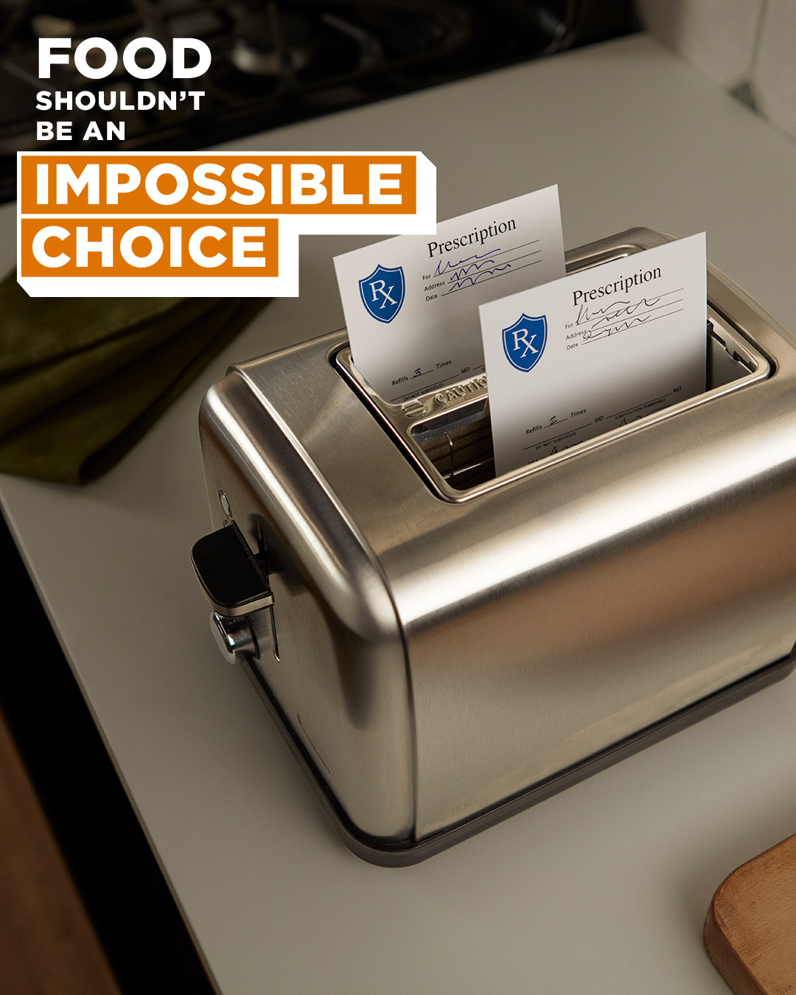


SOCIAL IMAGES
INSTAGRAM STATIC
LINK to files
11 HUNGER ACTION MONTH 2022 TOOLKIT

Slide 12


SOCIAL IMAGES
ADVOCACY
LINK to files
INSTAGRAM
FACEBOOK/TWITTER
12 HUNGER ACTION MONTH 2022 TOOLKIT

Slide 13
SOCIAL COPY
FACEBOOK/TWITTER
Medicine should never come at the expense of food. This is just one of the impossible choices that millions of people often face. Join [FOOD BANK] in the fight to end hunger at [FOOD BANK URL]. #HungerActionMonth #EndHunger
Food or electricity? It shouldn’t be a choice. This Hunger Action Month, choose to end the impossible choices of hunger. Join [FOOD BANK] in the fight to end hunger at [FOOD BANK URL]. #HungerActionMonth #EndHunger
Nobody should have to choose between food and childcare, an impossible choice that millions of people often face. Join [FOOD BANK] in the fight to end hunger at FOOD BANK URL. #HungerActionMonth #EndHunger
INSTAGRAM
Medicine should never come at the expense of food. This is just one of the impossible choices that millions of people often face. Join [FOOD BANK] in the fight to end hunger at the link in our bio. #HungerActionMonth #EndHunger
Food or electricity? It shouldn’t be a choice. This Hunger Action Month, choose to end the impossible choices of hunger. Join [FOOD BANK] in the fight to end hunger at the link in our bio. #HungerActionMonth #EndHunger
Nobody should have to choose between food and childcare, an impossible choice that millions of people often face. Join [FOOD BANK] in the fight to end hunger at the link in our bio. #HungerActionMonth #EndHunger
13 HUNGER ACTION MONTH 2022 TOOLKIT

Slide 14
SOCIAL COPY
LINKEDIN
Food or medicine?
Food or childcare?
Food or electricity?
Nobody should be faced with a choice between food and other basic needs. But people facing hunger in our own community may be faced with an impossible choice like.
September is Hunger Action Month, and companies across [LOCAL COMMUNITY] are joining [FOOD BANK] in the fight to end hunger.
Here are five ways you and your employees can take action this September:
Sort and pack food: Turn a company outing into a fun, helpful group activity – assembling food boxes for distribution to families.
Volunteer: Create opportunities for employees to help feed our neighbors at [FOOD BANK].
Move leftover product: Offer your employees paid time off to move a grocery store’s unsold products to our food bank each week.
Collect food: Host a virtual food drive at your next company event.
Conduct a workplace giving campaign: Hold a workplace giving campaign. Be sure the company leads by example with a gift!
Food shouldn’t be an impossible choice, and your company can help end hunger. Click here [FOOD BANK URL] to find out how you can help our neighbors this September.
#hungeractionmonth #endhunger
14 HUNGER ACTION MONTH 2022 TOOLKIT

Slide 15
SOCIAL COPY
ADVOCACY
Medicine should never come at the expense of food. This #HungerActionMonth, join [FOOD BANK], in the fight to end hunger, and tell our local elected officials that food shouldn’t be an impossible choice.
Nobody should have to choose between food or childcare, an impossible choice millions of people in America are often face. This #HungerActionMonth, join [FOOD BANK] in the fight to end hunger and tell our local elected officials that food shouldn’t be an impossible choice.
Food or electricity? It should never be a choice. This #HungerActionMonth, join [FOOD BANK] in the fight to end hunger and tell our local elected officials that food shouldn’t be an impossible choice.
15 HUNGER ACTION MONTH 2022 TOOLKIT

Slide 16

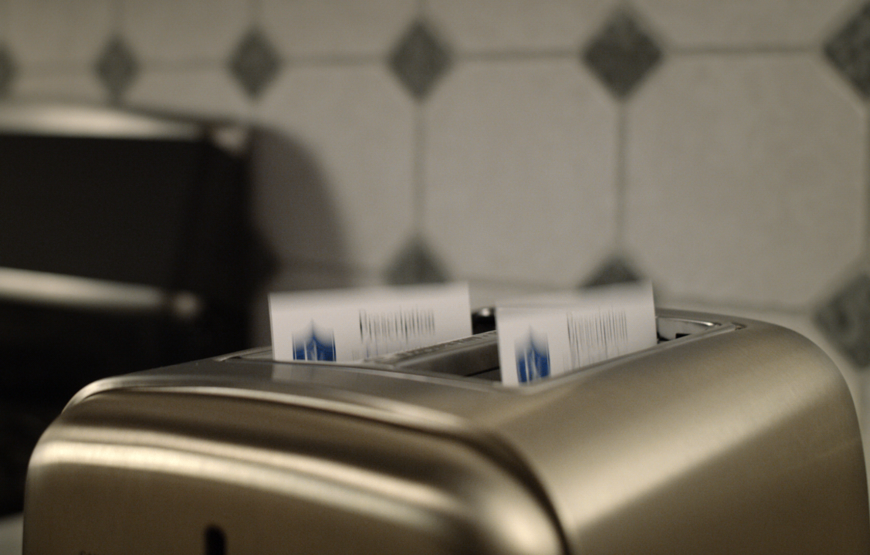
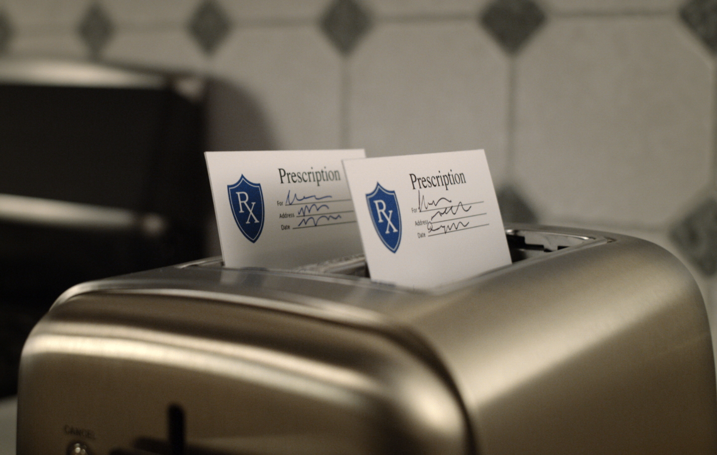
ANIMATED GIF
LINK to GIF
16 HUNGER ACTION MONTH 2022 TOOLKIT

Slide 17

FLYERS
LINK to files
These flyers can be customized to include your logo:
Open PDF in Adobe Acrobat
To add your food bank logo, hover your mouse over the box to the right of the HAM logo until your cursor changes and right-click to browse for your logo file.
If adding your logo, navigate to the relevant logo file (you may have to change the file type drop down to ensure that you can select the file type of your logo), hit “Select,” format then re-save the PDF with your logo file included.
Food Bank Logo Here
17 HUNGER ACTION MONTH 2022 TOOLKIT

Slide 18
SAMPLE
BLOG POST
[INSERT AN EXAMPLE OF FOOD CHOICES THAT IS AUTHENTIC AND RELEVANT. SEE BELOW FOR SAMPLE LANGUAGE.]
Last night, my family was choosing what to have for dinner. We talked through endless options. We could make pasta, but we couldn’t decide between brands of sauce we had. We could eat out, but we couldn’t decide where we all would enjoy. We ended up raiding our pantry for what each of us wanted and made four separate items to meet our individual tastes. This happens more often than I’d like to admit. The point is, though, that we had choices. Lots and lots of great choices.
For millions of people in America, a daily meal can often be an impossible choice between food and other critical needs—like medicine, utilities or childcare. It is not the choice of what to eat. The choice is if they eat.
September is Hunger Action Month®. Join the fight to end hunger at [FOOD BANK URL].
18 HUNGER ACTION MONTH 2021 TOOLKIT

Slide 19
SAMPLE
E-NEWSLETTER COPY
September is Hunger Action Month® and [Food Bank] wants to encourage everyone to take action to end hunger.
For millions of people in America, a daily meal is a choice between food and other critical needs—like medicine, housing, or transportation. No one should have to make those types of choices.
This September, choose to end hunger.
Join the fight to end hunger at [FOOD BANK URL].
19 HUNGER ACTION MONTH 2021 TOOLKIT

Slide 20
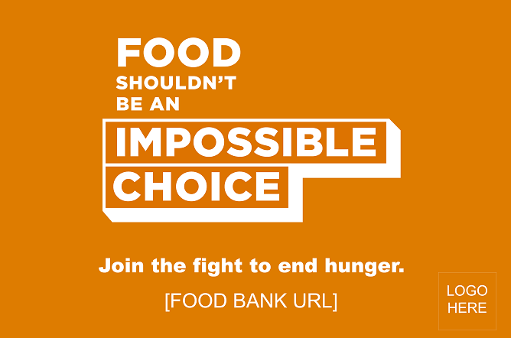
YARD SIGN TEMPLATE
LINK to files
20 HUNGER ACTION MONTH 2022 TOOLKIT

Slide 21
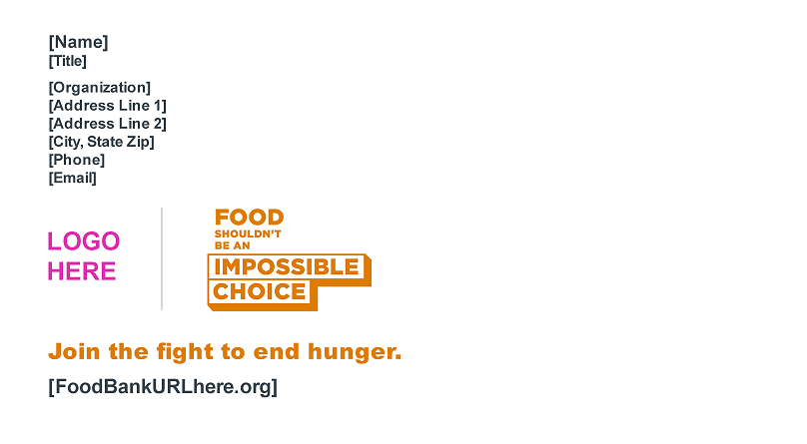
EMAIL SIGNATURE TEMPLATE
LINK to files
21 HUNGER ACTION MONTH 2022 TOOLKIT

Slide 22
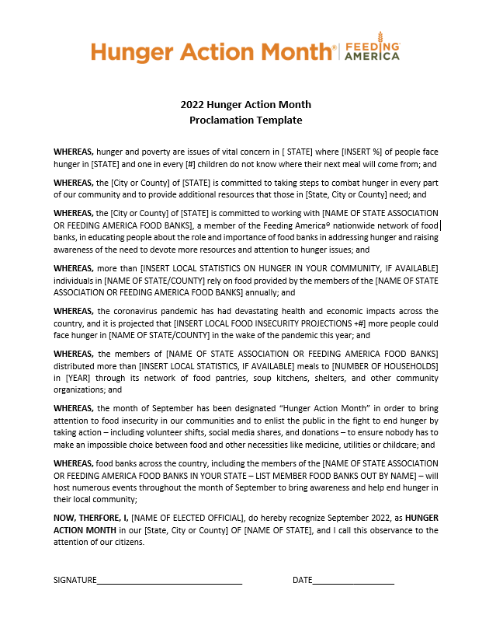
PROCLAMATION TEMPLATE
LINK to template
22 HUNGER ACTION MONTH 2022 TOOLKIT

Slide 23
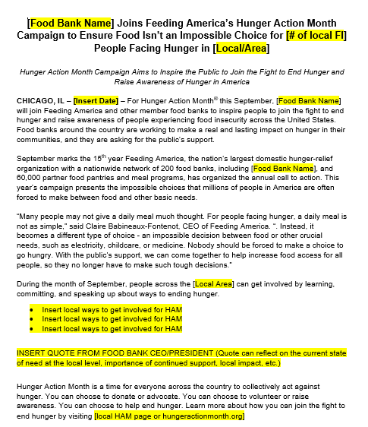
PRESS RELEASE TEMPLATE
LINK to template
23 HUNGER ACTION MONTH 2022 TOOLKIT

Slide 24
MEDIA PITCH IDEAS
[City] is Turning Orange for Hunger Action Month: If your food bank has coordinated the turning orange of any landmark buildings in your city or service area, invite media to be there for the moment. If you can, invite a local celebrity or government official to draw additional attention to the issue and the event. ​
[X Station] is Turning Orange for Hunger Action Day: Ask your local media contacts if they would wear orange on Hunger Action Day, and ask their anchors to wear orange ties, dresses, etc. as well. You can offer up your CEO/ED for an in-studio interview about Hunger Action Month and Hunger Action Day, and to provide ways for viewers to take action.​
24 HUNGER ACTION MONTH 2022 TOOLKIT

Slide 25
MEDIA REMINDERS
Elevate Media From Local to National​
If you have big success with securing media in your local market – tell us about it! When we can, we try to get your local stories placed in national media.​​
Already have big events or announcements planned for September? Please share these key items with us and we’ll see if a national opportunity is possible.​​
Reminder: Elevating a story to national media results in a national placement for your local food bank and does not nullify coverage in your local market.​
Please email your Hunger Action Month media ideas or coverage to hungeractionmonth@feedingamerica.org ​
25 HUNGER ACTION MONTH 2022 TOOLKIT

Slide 26
ENGAGEMENT & ACTIVATION
IDEAS
26 HUNGER ACTION MONTH 2022 TOOLKIT

Slide 27
SUPPORTER & COMMUNITY ENGAGEMENT
INDIVIDUAL ACTIONS
LEARN
SHARE ON SOCIAL
Visit [FOOD BANK] or [map.feedingamerica.org] to learn about hunger in America and in our community.
Post on social media about why you are a part of the fight to end hunger and encourage your friends, family and followers to join you.
  Leverage our Hunger Action Month social graphics and suggested copy or craft your own.
  Pin a post about Hunger Action Month to the top of your Instagram. For instructions, click here.
  Use [FOOD BANK’S] Facebook frame and encourage your friends and followers to do the same.
DONATE
Make a donation to [FOOD BANK]
  Request that your company match donations via your employer match your donation through its corporate matching gift program.
  Make your own coffee and lunch during the month of September and donate your savings to [FOOD BANK]
  Start a Facebook fundraiser and challenge your followers to reach a certain goal.
ADVOCATE
Write to your local Congress member and tell them food shouldn’t be an impossible choice. Find out how at [Food Bank URL].
VOLUNTEER
WEAR ORANGE
Volunteer at [FOOD BANK] and tell your friends, family and colleagues to join you.
Wear orange—the color of hunger relief— throughout the month of September to spread awareness while demonstrating your commitment to the fight against hunger in America.
27 HUNGER ACTION MONTH 2022 TOOLKIT

Slide 28
DONOR & PARTNER ENGAGEMENT
GROUP ACTIONS
DONATE
SHARE ON SOCIAL
Make a financial gift or significant product donation to [FOOD BANK].
Start a company fundraising campaign
  Show your support by adding a match on funds raised.
  Have different teams or departments challenge each other to see who can raise the most funds.
  Invite customers to join in raising a certain number of meals for people facing hunger.
Post on social media about you and/or your company's involvement in the anti-hunger movement, your support of [FOOD BANK], and your participation in Hunger Action Month this September.
Take a team photo with everyone dressed in orange and post it to your social media pages with the hashtags #HungerActionMonth and #EndHunger and tag [FOOD BANK SOCIAL HANDLE].
Have a competition to see who wears the most orange throughout the month and post the winner’s photo on social media.
Use [FOOD BANK’S] Facebook frame on your company’s Facebook page and encourage your followers to do the same.
VOLUNTEER
Organize a group volunteer event at [FOOD BANK] or [PARTNER AGENCY], a partner agency of [FOOD BANK].
LEND MEDIA SUPPORT
Spread awareness of the fight to end hunger by running donating space in your media channels to run [FOOD BANK’S] ads.
GO ORANGE
Turn your building orange or ask community members to turn their landmarks orange throughout September. ​
28 HUNGER ACTION MONTH 2022 TOOLKIT

